Slide 1
Polygenic Disorders
Caleb Lareau

Slide 2
Overview
Motivation
Authors
Polygenic Risk Scoring
Power et al.
Future work
LD Score Regression
LD Hub

Slide 3
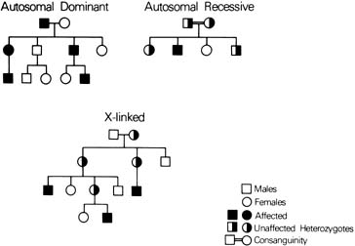

Slide 4
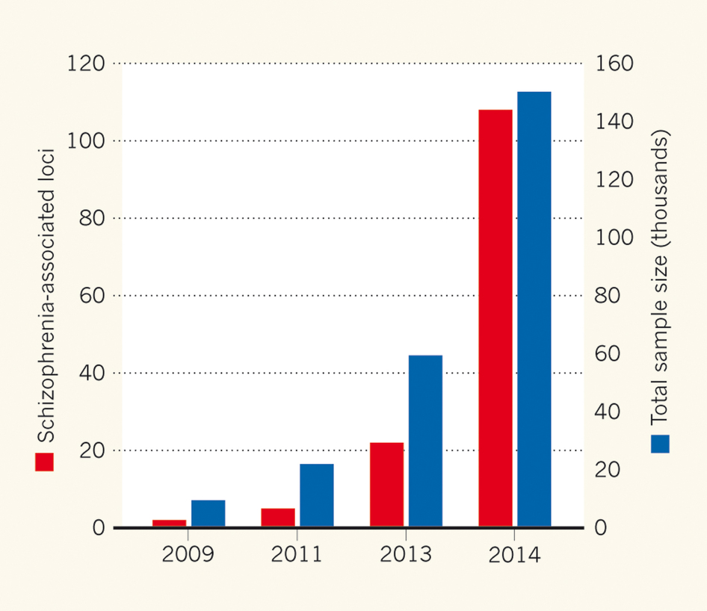

Slide 5
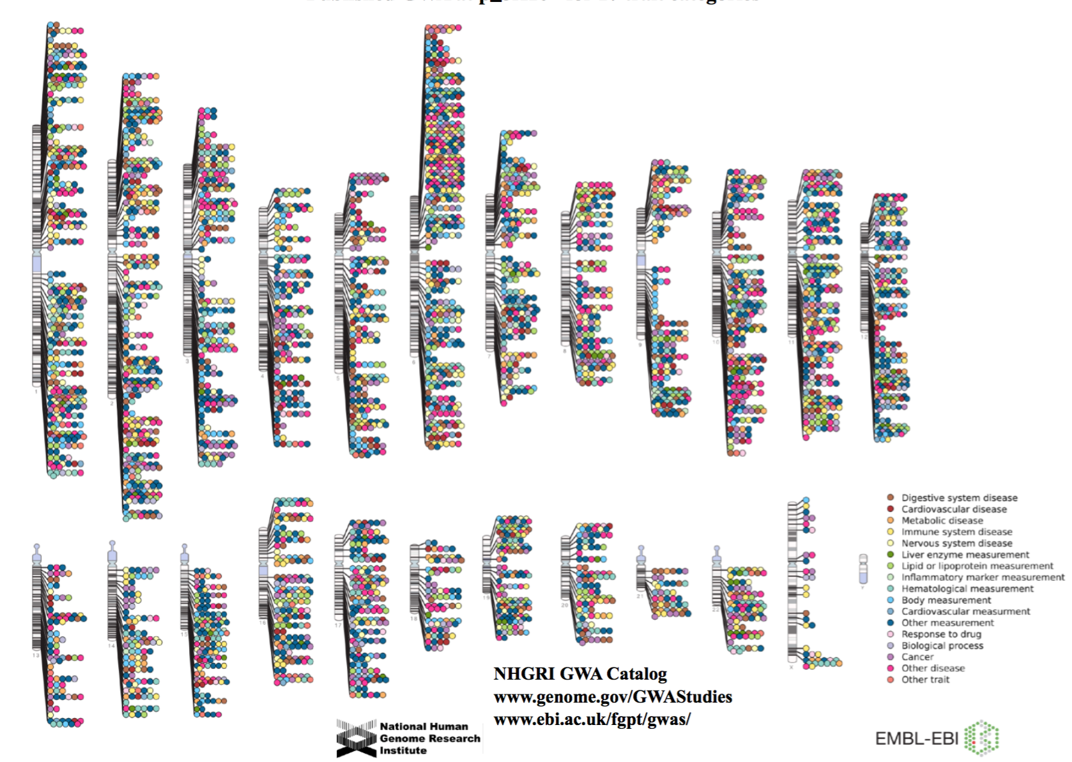

Slide 6
From GWAS…
How do we predict risk of disease?
Is this risk clinically actionable?
Can genetics be used to inform treatment?
Precision Medicine
Can genetic profiles predict human attributes?

Slide 7

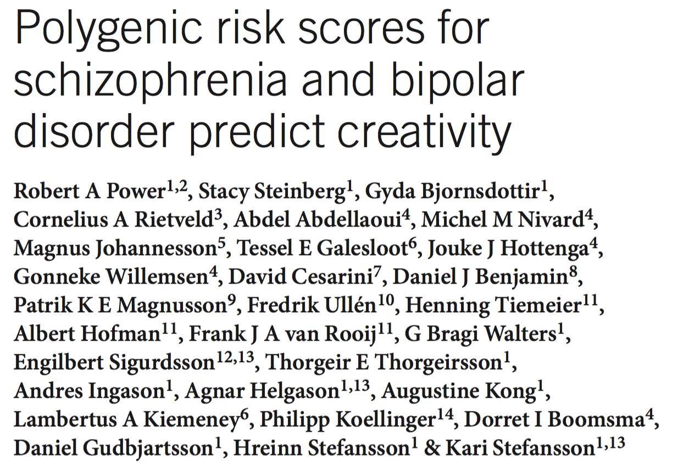

Slide 8

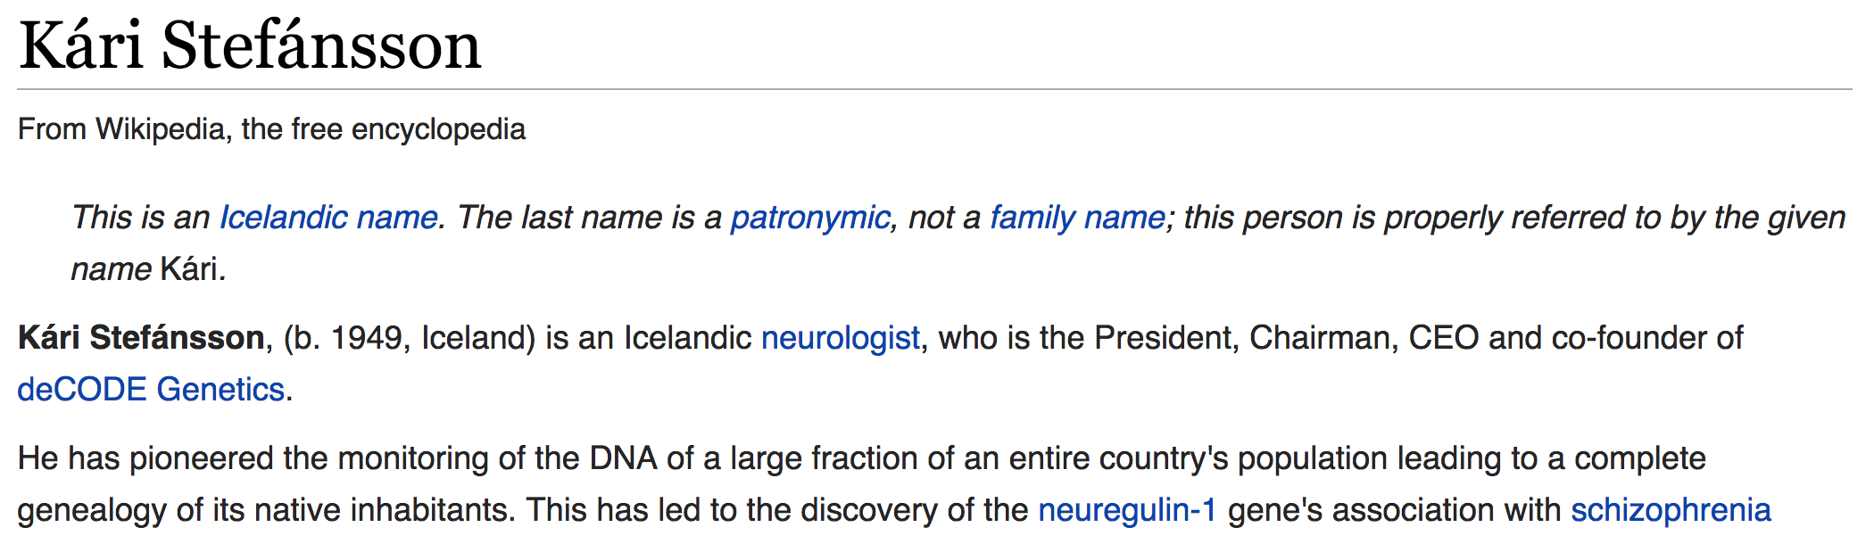

Slide 9
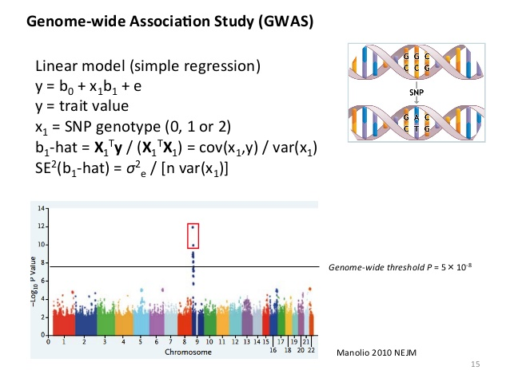

Slide 10
Polygenic Risk Scoring
Methodology that computes one score per individual based on genetic risk in another population
Variant Thresholding
Linkage Disequilibrium (“Clumping”)
Continuous and discrete outcomes

Slide 11
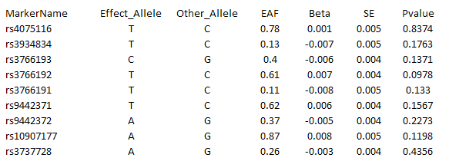
GWAS Results
show PRS on board…

Slide 13
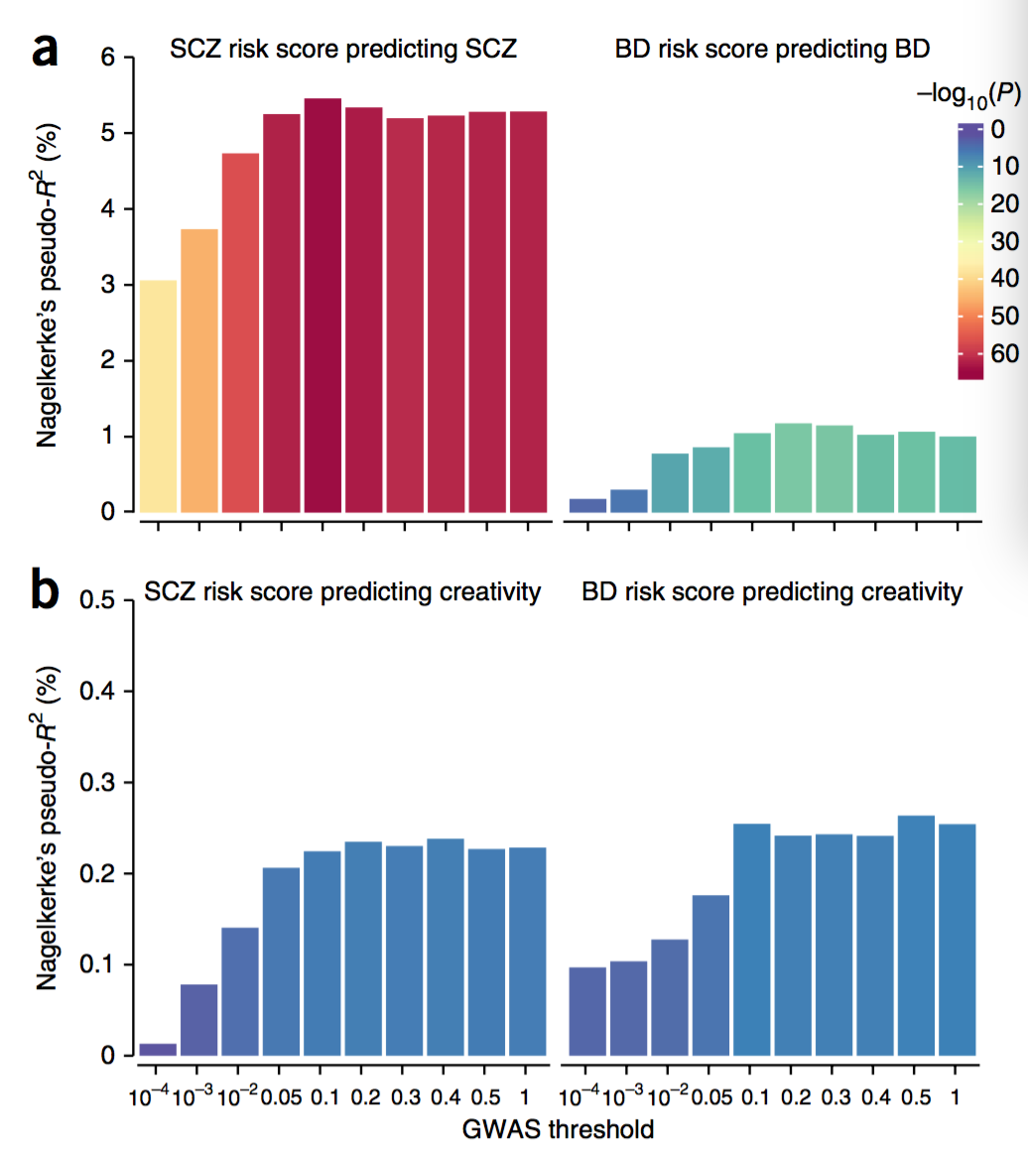

Slide 14
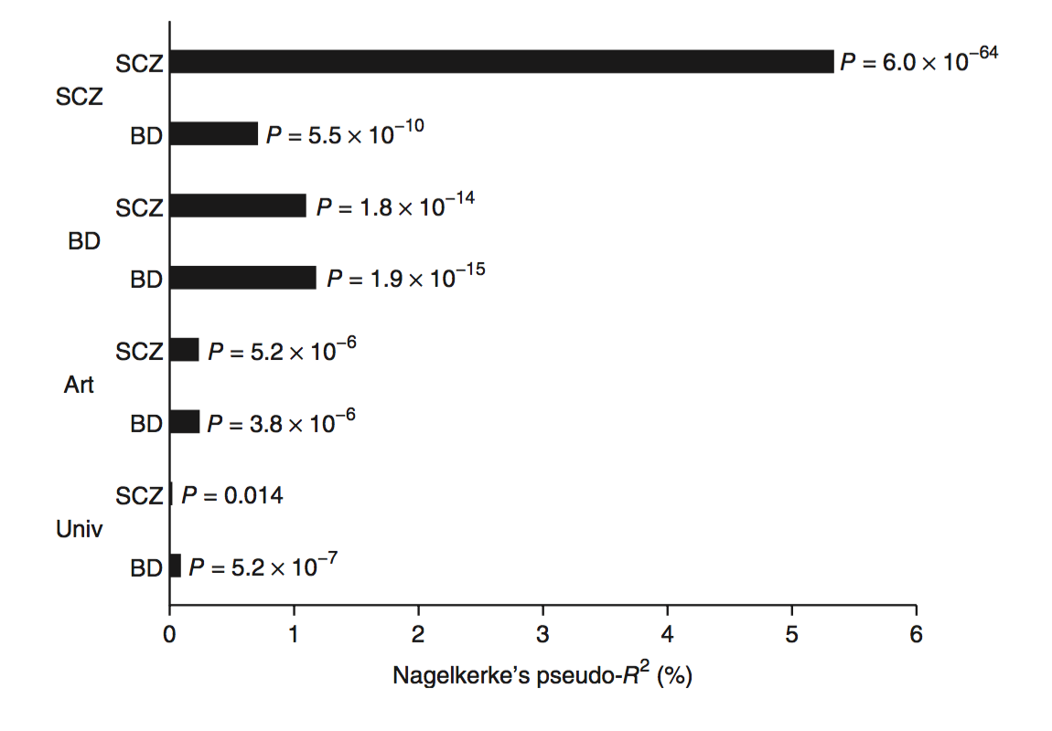

Slide 15
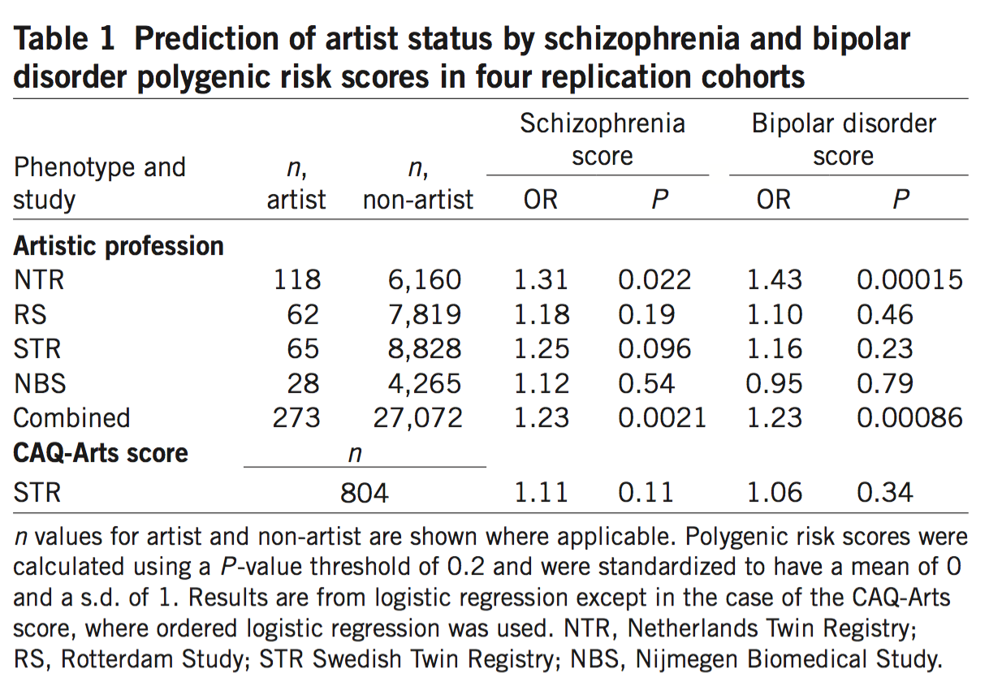

Slide 16
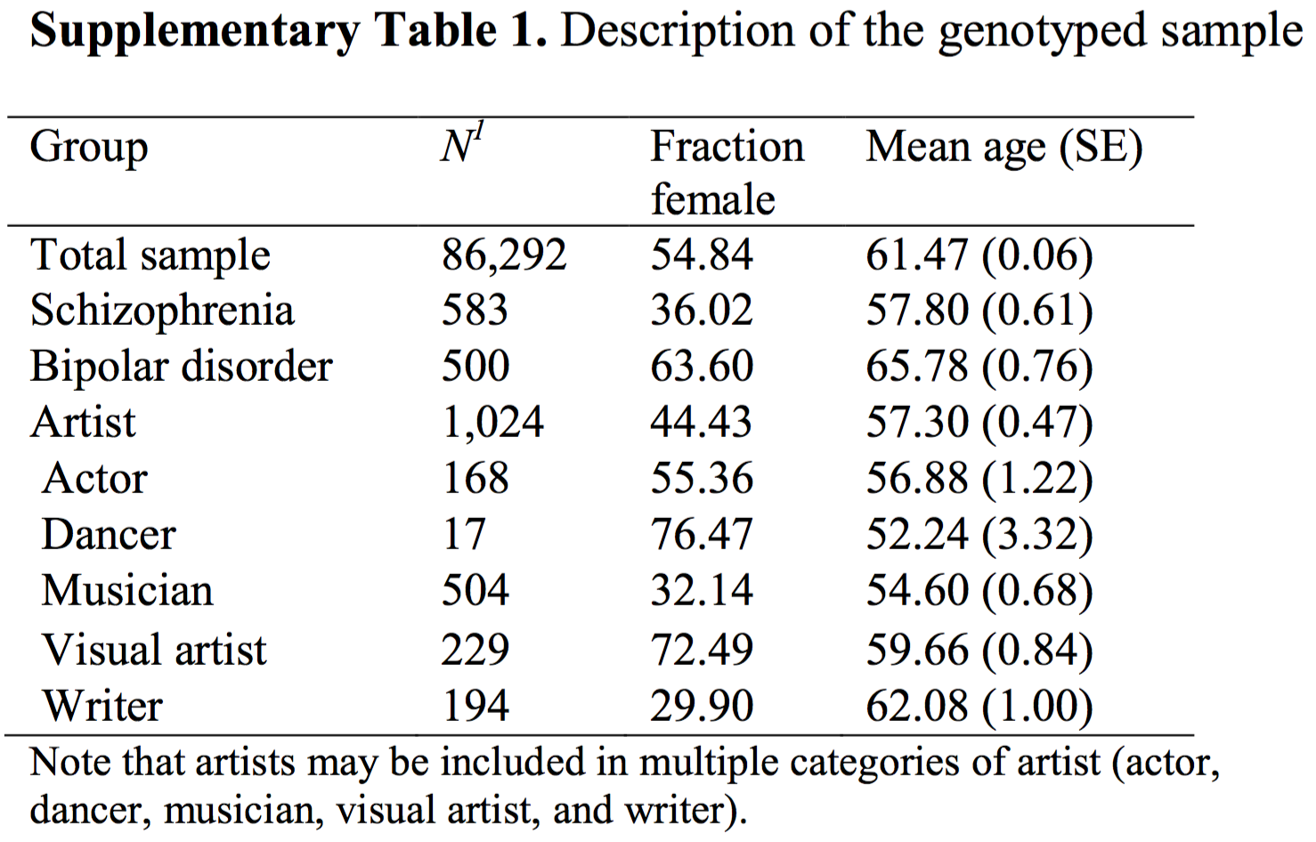

Slide 17
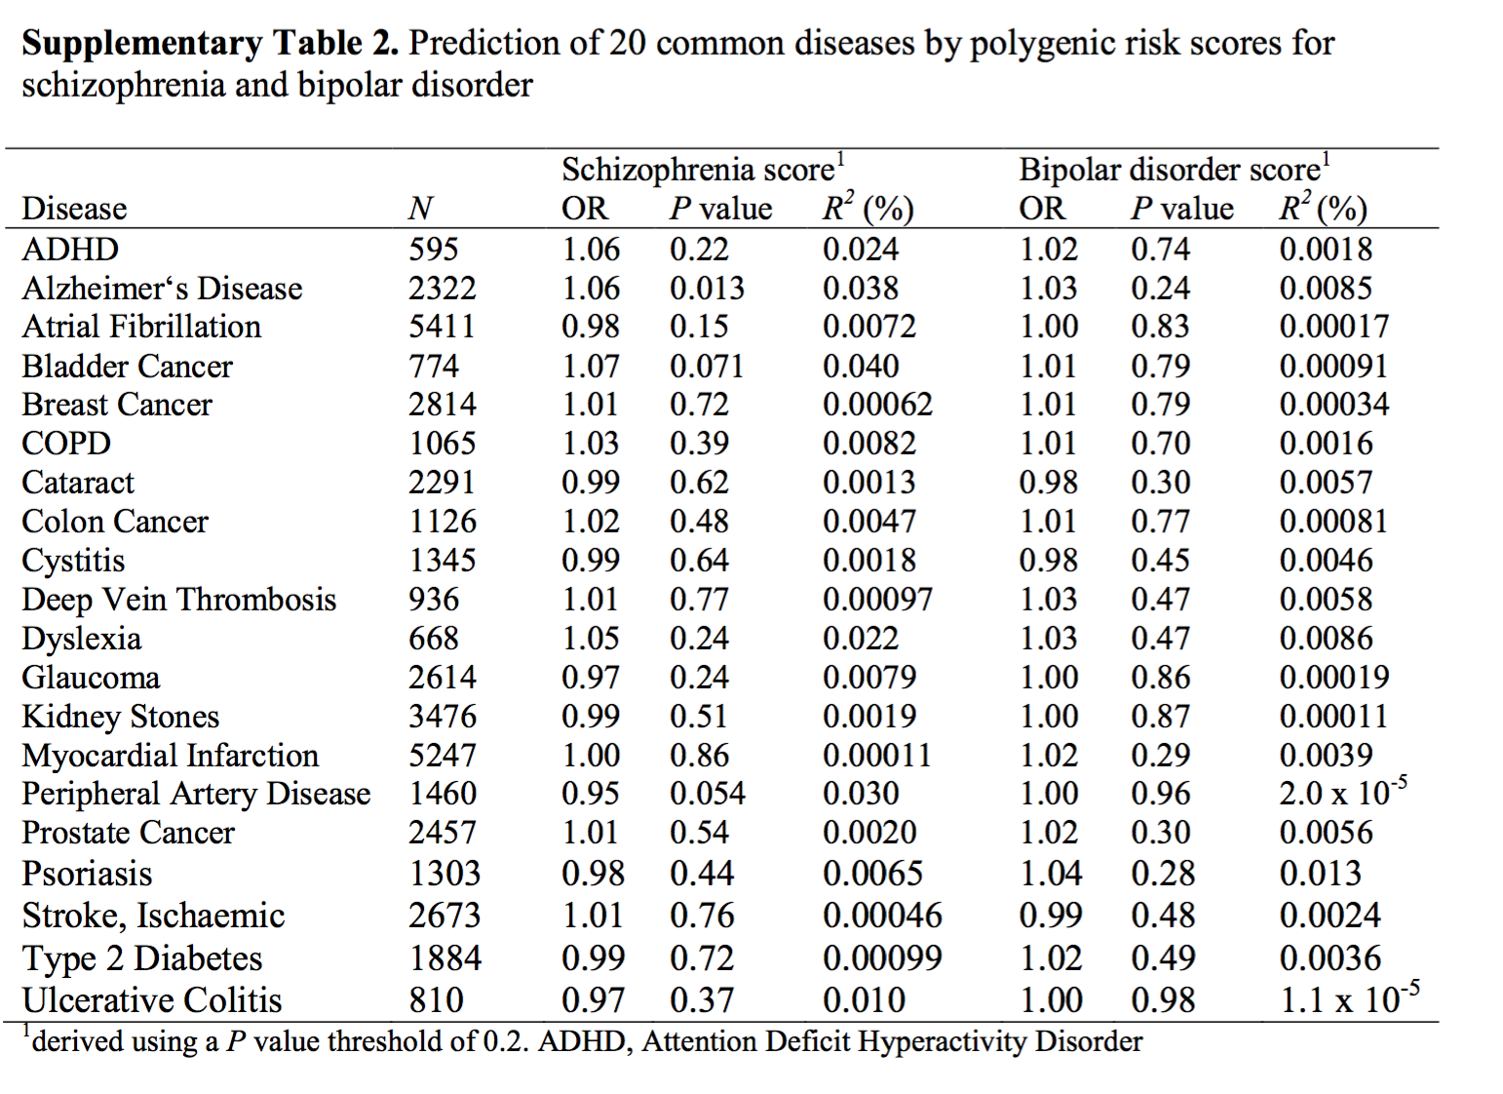

Slide 18
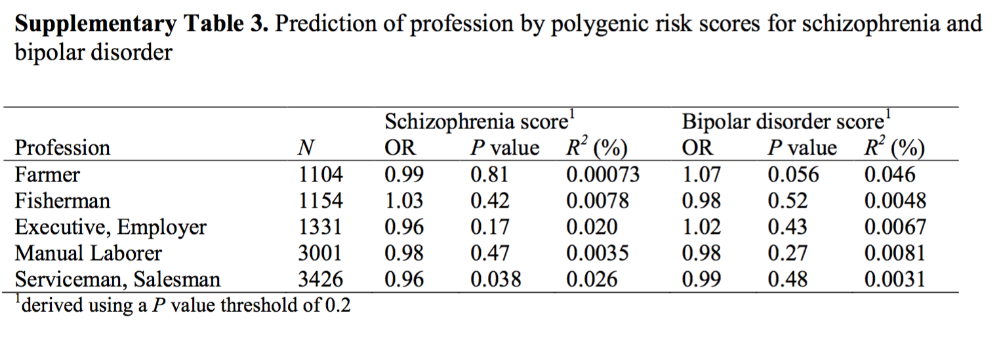

Slide 19
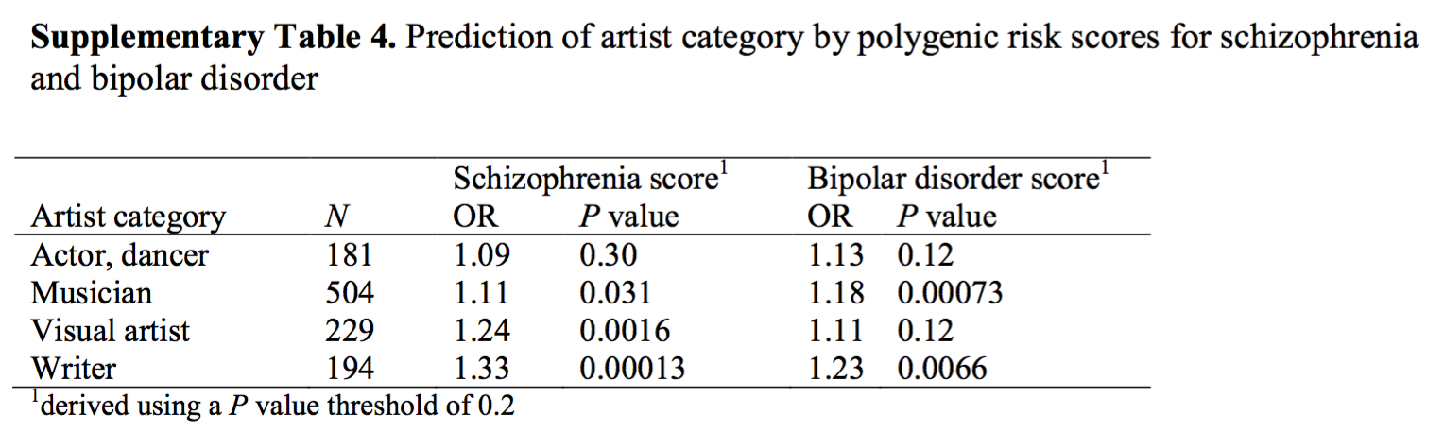

Slide 20
What else have PRS taught us?

Slide 21
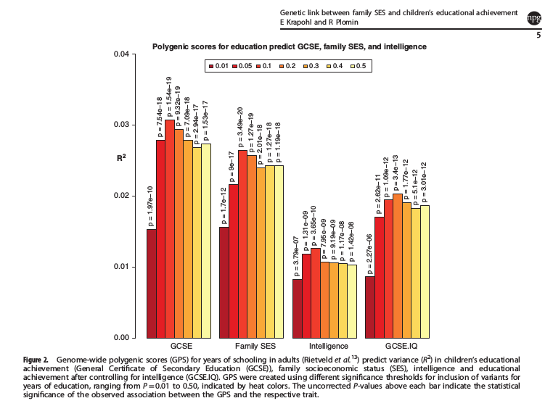
Mediated by intelligence …

Slide 22
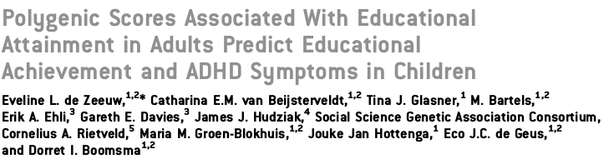
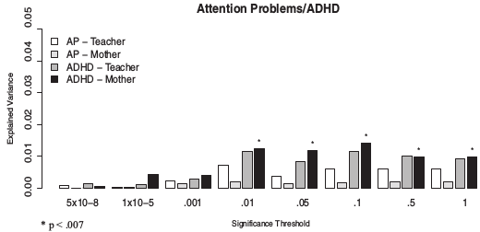
and ADHD!

Slide 23
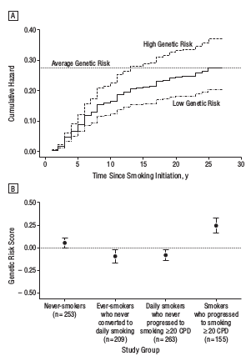
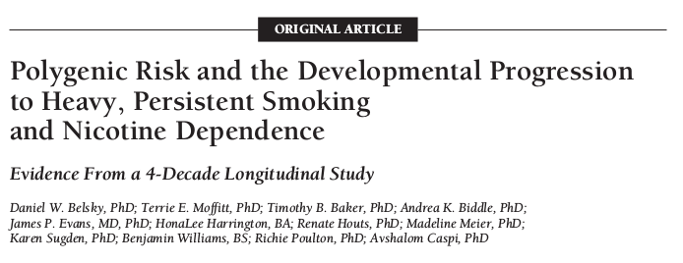

Slide 24
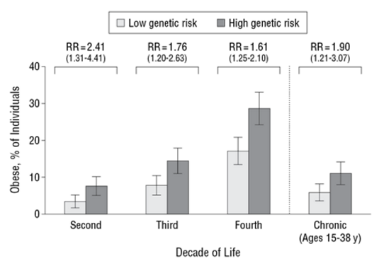
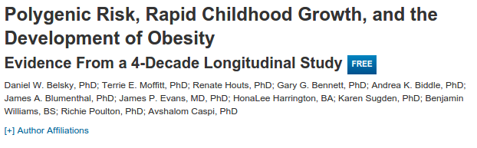
BMI

Slide 25
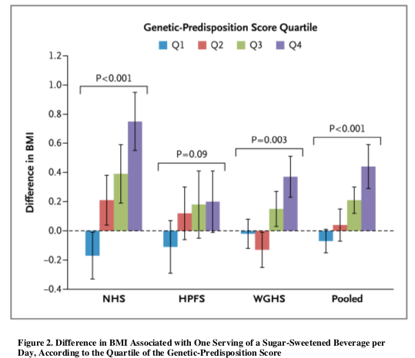
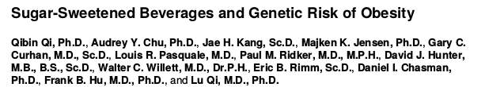

Slide 26
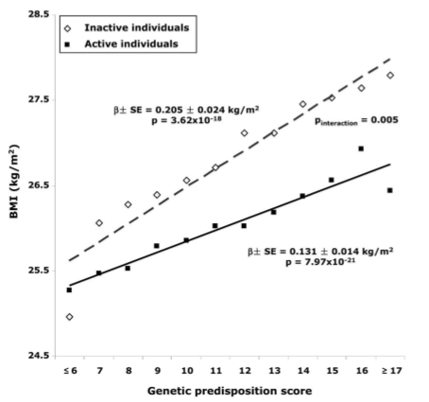
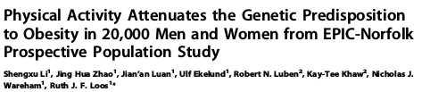

Slide 27
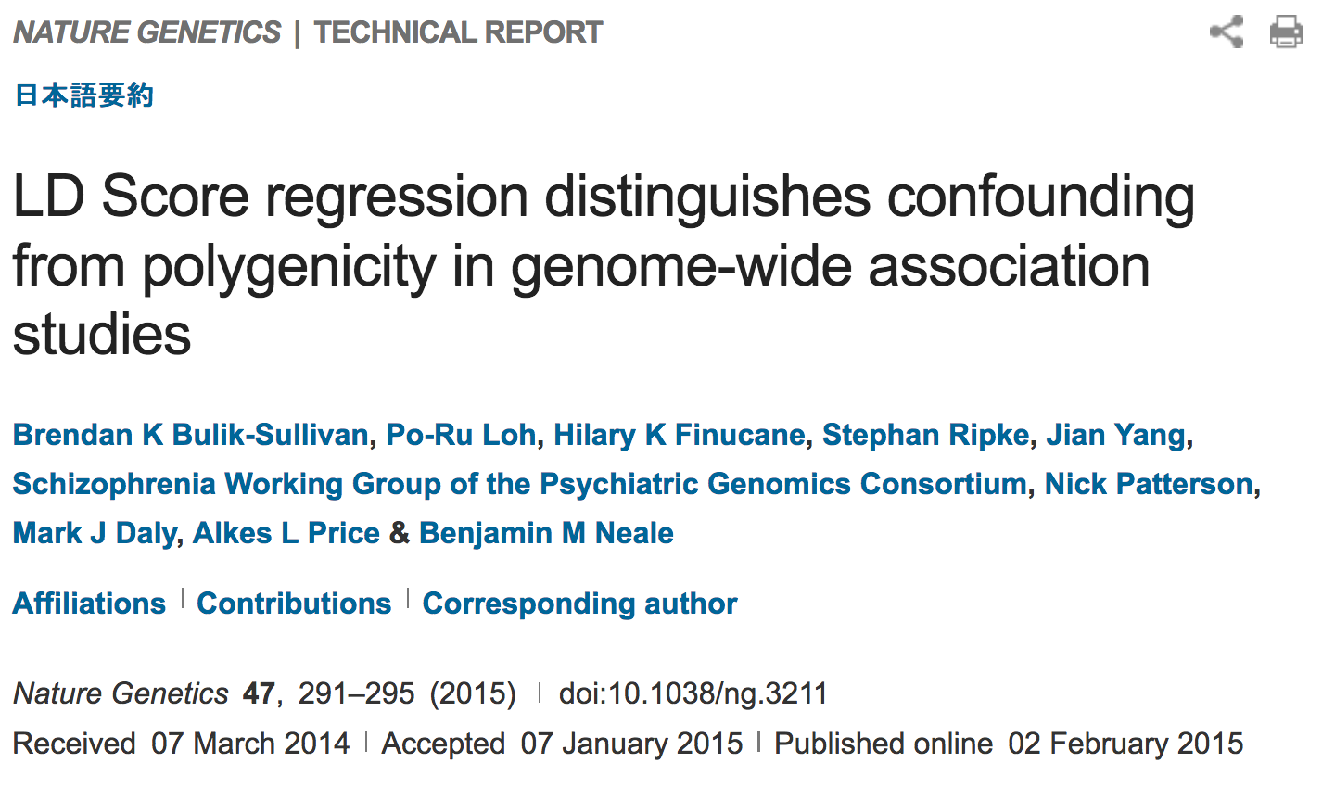

Slide 28
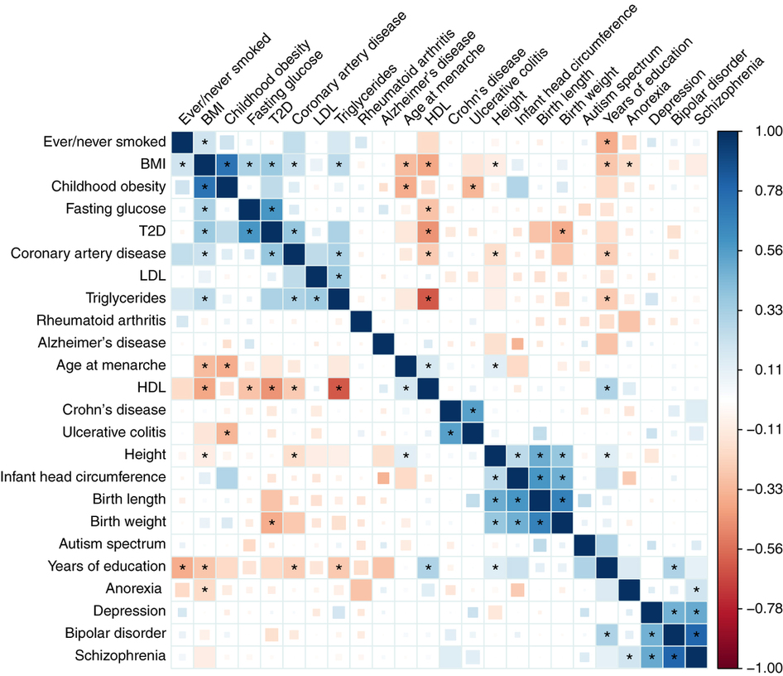

Slide 29
LD Hub
http://ldsc.broadinstitute.org/

Slide 30
Thanks!

